Slide 1
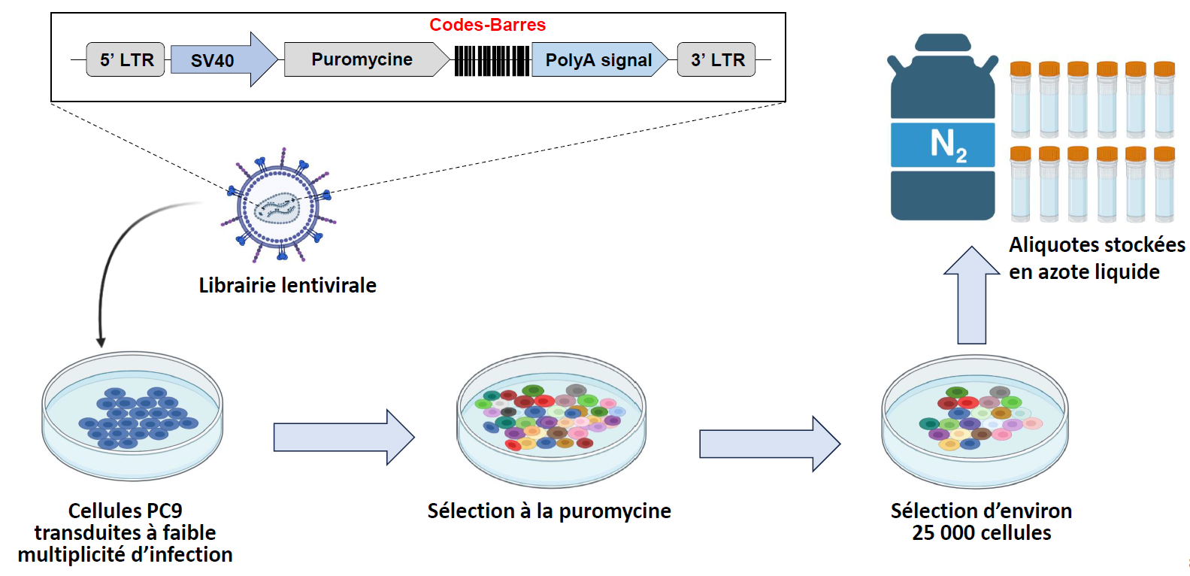

Slide 2
Workflow
-eliminate barcodes for which the combined counts of the 4 controls are <5
-normalize barcodes so that total number of counts is 100 000
-calculate mean of the 4 controls
-calculate the fold change vs control (mean) for each drug replicate
-if fc>3 🡪 1, if not 🡪 0
Osimer1_100n_exp010821_run180821_07 | Osimer2_100n_exp010821_run180821_08 | Osimer3_100n_exp010821_run180821_09 | Osimer4_100n_exp010821_run180821_10 | , | Osimer1_100n_exp010821_run180821_07 | Osimer2_100n_exp010821_run180821_08 | Osimer3_100n_exp010821_run180821_09 | Osimer4_100n_exp010821_run180821_10 | Osimer_100n_exp010821_run180821
0,31 | 0,25 | 0,34 | 0,34 |  | 0 | 0 | 0 | 0 | 0
0,27 | 0,19 | 0,33 | 0,24 |  | 0 | 0 | 0 | 0 | 0
5,44 | 4,50 | 5,44 | 4,78 |  | 1 | 1 | 1 | 1 | 4
0,92 | 0,79 | 0,69 | 0,63 |  | 0 | 0 | 0 | 0 | 0
0,53 | 0,62 | 0,73 | 0,58 |  | 0 | 0 | 0 | 0 | 0
0,22 | 0,28 | 0,22 | 0,14 |  | 0 | 0 | 0 | 0 | 0
0,50 | 0,46 | 0,59 | 0,54 |  | 0 | 0 | 0 | 0 | 0
1,28 | 1,67 | 1,54 | 1,73 |  | 0 | 0 | 0 | 0 | 0
0,51 | 0,59 | 0,66 | 0,53 |  | 0 | 0 | 0 | 0 | 0
0,39 | 0,53 | 0,50 | 0,48 |  | 0 | 0 | 0 | 0 | 0
-calculate the sum for the four replicates

Slide 3
What are the chances to have a barcode randomly enriched in all four replicates?
Osimertinib
Trametinib
Pemetrexed
Osimer1_100n_exp010821_run180821_07 | Osimer2_100n_exp010821_run180821_08 | Osimer3_100n_exp010821_run180821_09 | Osimer4_100n_exp010821_run180821_10 | sum | Tramet1_030n_exp010821_run180821_11 | Tramet2_030n_exp010821_run180821_12 | Tramet3_030n_exp010821_run180821_13 | Tramet4_030n_exp010821_run180821_14 | sum | Pemetr1_100n_exp010821_run180821_15 | Pemetr2_100n_exp010821_run180821_16 | Pemetr3_100n_exp010821_run180821_17 | Pemetr4_100n_exp010821_run180821_18 | sum
0 | 0 | 0 | 0 | 0 | 0 | 0 | 0 | 0 | 0 | 0 | 0 | 0 | 0 | 0
0 | 0 | 0 | 0 | 0 | 0 | 0 | 0 | 0 | 0 | 0 | 0 | 0 | 0 | 0
1 | 1 | 1 | 1 | 4 | 0 | 0 | 0 | 0 | 0 | 0 | 0 | 0 | 0 | 0
0 | 0 | 0 | 0 | 0 | 0 | 0 | 0 | 0 | 0 | 0 | 0 | 0 | 0 | 0
0 | 0 | 0 | 0 | 0 | 0 | 0 | 0 | 0 | 0 | 0 | 0 | 0 | 0 | 0
0 | 0 | 0 | 0 | 0 | 0 | 0 | 0 | 0 | 0 | 0 | 0 | 0 | 0 | 0
0 | 0 | 0 | 0 | 0 | 0 | 0 | 0 | 0 | 0 | 0 | 0 | 0 | 0 | 0
0 | 0 | 0 | 0 | 0 | 0 | 0 | 0 | 0 | 0 | 0 | 0 | 0 | 0 | 0
0 | 0 | 0 | 0 | 0 | 0 | 0 | 0 | 0 | 0 | 0 | 0 | 0 | 0 | 0
0 | 0 | 0 | 0 | 0 | 0 | 0 | 0 | 0 | 0 | 0 | 0 | 0 | 0 | 0
0 | 0 | 0 | 0 | 0 | 0 | 0 | 0 | 0 | 0 | 0 | 0 | 0 | 0 | 0
Total barcodes: 10881
Osimertinib
Trametinib
Pemetrexed
630 | 626 | 658 | 622 |  | 1091 | 1061 | 1017 | 1058 |  | 1711 | 1776 | 1741 | 1831
0,05789909 | 0,05753148 | 0,06047238 | 0,05716386 | 1,15E-05 | 0,10026652 | 0,09750942 | 0,09346567 | 0,09723371 | 8,8E-05 | 0,15724658 | 0,16322029 | 0,16000368 | 0,16827497 | 0,00069
 |  |  |  | 0,125 |  |  |  |  | 0,967 |  |  |  |  | 7,519
 |  |  |  | 294 |  |  |  |  | 323 |  |  |  |  | 608
Probability of having sum=4
Expected barcodes with sum=4
Observed barcodes with sum=4

Slide 4
-I did this for all the experiments, then David assembled the different files with Galaxy
 | Osimer_100n_exp010821_run180821 | Tramet_030n_exp010821_run180821_11 | Pemetr_100n_exp010821_run180821_15
CAGCTTGACCATCTGCTGTTACTCGGACAGGAATAAGGCGA | 0 | 0 | 0
CATGGCGAAGATGAGCGAAGACTGGGACAGGATTGACGCGA | 0 | 0 | 0
GATCTCGTAGAACATTTGCGGATACTCCTACAACGTTTAGG | 4 | 0 | 0
GATCACCTTGAGCATTAGCCGGGACTGTTACACGTTTGAGG | 0 | 0 | 0
GATCAAGGTGAAGATGTGCACCGACTGACACATCATTAACG | 0 | 0 | 0
GATCAACTTGACGATGAGCAAGTACTGGTACATGGGTCACG | 0 | 0 | 0
GATCAGCAGGAGGATAAGCTTTTACTGTAACATCGTTGAGG | 0 | 0 | 0
CTGCGAGAACATCAGCATCGACTCCAACAGCCTATAGGCGA | 0 | 0 | 0
GATCAGCATGAAGATGTGCTGATACTGTTACATCCATTACG | 0 | 0 | 0
GATCTAGTGGAAGATTAGCATATACTGGAACAGCTGTCAGG | 0 | 0 | 0
GATCAGCGGGAACATTTGCGCCCACTGACACATCAAAGACG | 0 | 0 | 0
CTTCACGATGATAAGCTTGAACTGGTACATGATATAGGCGA | 4 | 0 | 0
CTGGTTGAGGATAAGCACCAACTCTCACAGGGGTCACGCGA | 0 | 0 | 0
CTTGTTGAACATGTGCGGGGACTGGAACATGCAACAGGCGA | 0 | 0 | 0
CACCCGGAGCATTTGCGTGGACTCGAACATGGTAGAGGCGA | 4 | 0 | 0
GATCTGGGCGAGGATGTGCTATGACTGGTACACGGCAGACG | 4 | 0 | 0

Slide 5
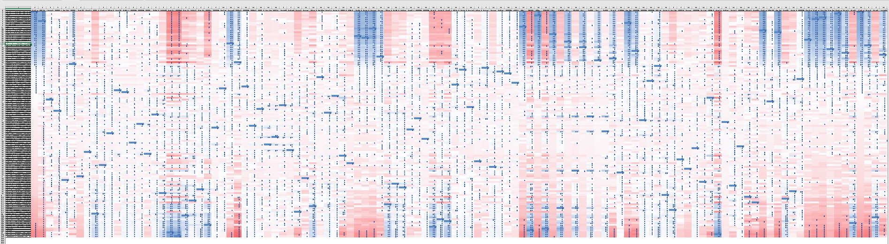
We obtained a table with 121 columns (treatments) and 26712 barcodes
- I kept only the barcodes that were present in all the drugs/columns: 6111 barcodes selected
- I transformed 4 🡪 1 and the rest 🡪 0 (binary) [except for osim three months, 3 replicates]
-Correlation matrix for the treatments

Slide 6
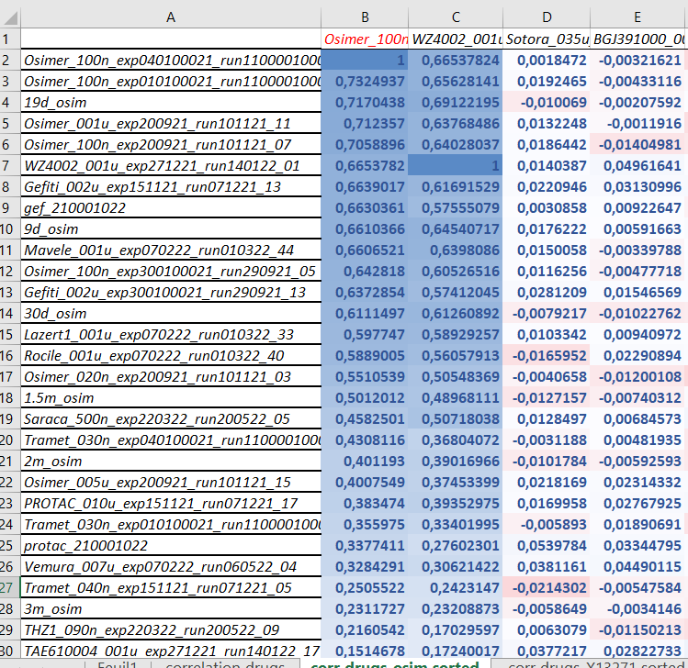

Slide 7
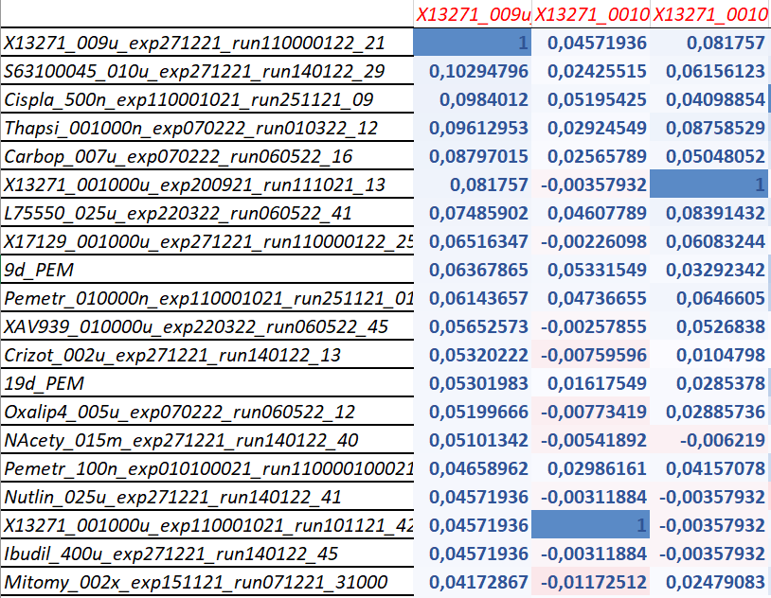
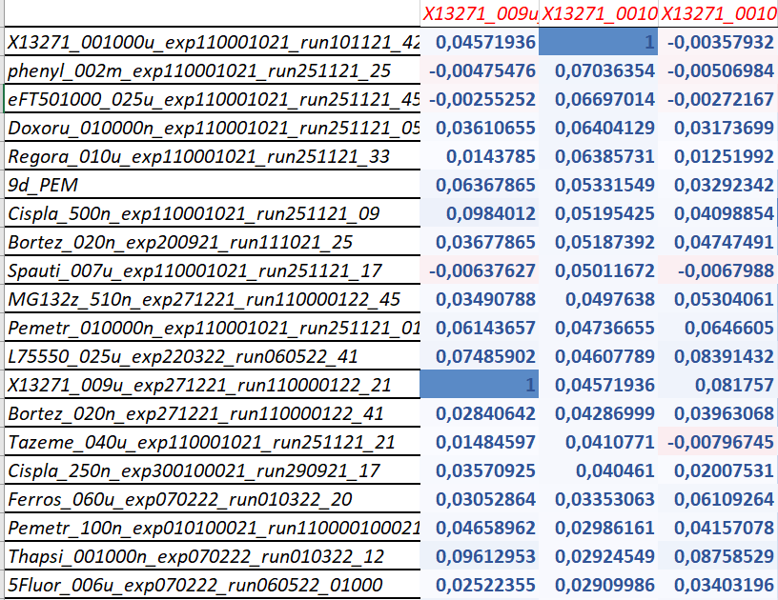
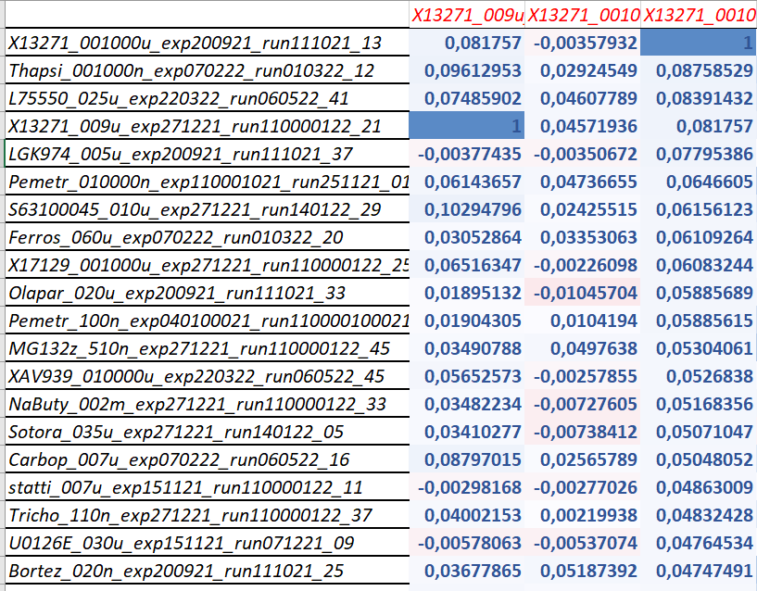

Slide 8
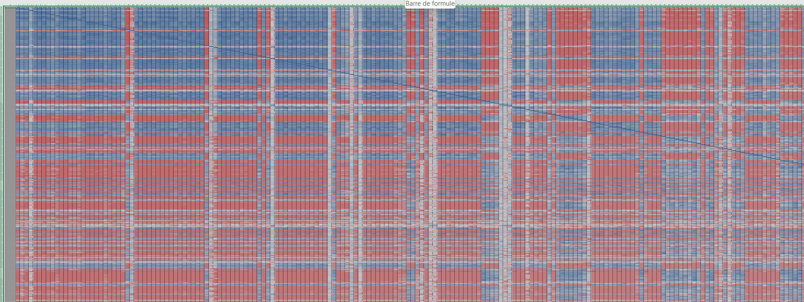
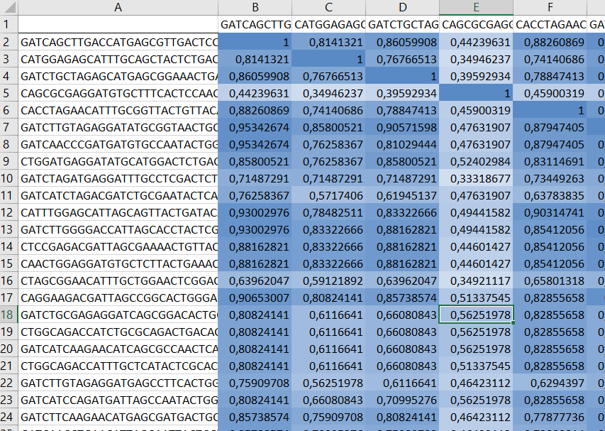
-Correlation matrix for the barcodes
-I selected barcodes displaying a sum of at least 1 🡪 4106 barcodes
-I selected barcodes displaying a sum of at least 10 🡪 657 barcodes

Slide 9
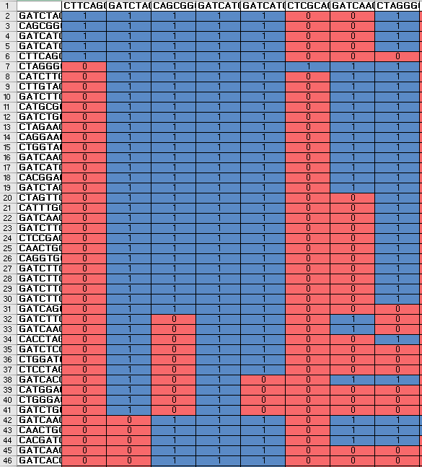
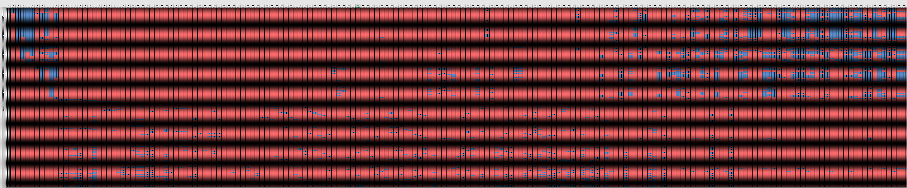
- To select barcodes highly correlated:
CC > 0,8 🡪 1 ; CC ≤ 0,8 🡪 0
- I discarded barcodes with sum < 5 (205 barcodes remaining)

Slide 10
1) Data management, barcode counts
Check number of rows (barcode IDs) by number of samples -> why are there so many discrepancies across batches (may not impact the outcome, however, we’re likely to be asked for it by reviewers)
In the original exp200921.TABULAR file provided, 20 replicates were missing: , replicates times 5 compounds (Palboc, Olapar, LGK9743, Chloro, Bafilo)
Format:
tsv or true csv (Excel creates some spurious changes to colnames + random clipping of large files)
(optional): DuckDB or Parquet local database for efficient exploration
So far, I fully discard:
exp130921 in vivo replicates
All T25 experiences: CTRL1_000u_exp281022_T25_run141222_06; PROTAC1_010u_exp281022_T25_run141222_10; Cetux1_020u_exp281022_T25_run141222_14; Gef1_002u_exp281022_T25_run141222_18. What’s meaning of T25?
p42 and p43
sorafetinib with 3 replicates, concentration 5 uM, date 300821, reported originally on Table of compounds, was discarded, as not found in the provided barcode counts -> normal to be discarded
Either we do not talk at all about early discarded replicates, or we show by proper visualisations or statistical testing that they are strong outliers.
I kept:
Time course experiences
Dose response
Drug combination: Osimertinb+sorafenib -> to be ^paired with osi and sora alone.
Would like to evaluate the impact of keeping only the most frequent Osimertinb concentrations across all replicates, or the drug concentration which has the most effect (+ from time courses, only keep the one after 9 days)

Slide 11
2) Data management, phenotype metadata
PEM prefix stands for Pemetrexed in time course experiences, right? (elsewhere `Pemetr`)
Format concentrations to moles (some were in moles, others in grams?), dates to ISO (year-month-day) and Duration to days, assuming months of 30 days.
Map on the same table the replicates’ columns with their respective general features and original Compound names.
Could we consider Time Course along with more classical experiments of exp200921 as the same batch? Important for statistical analyses.
Final, consensual pheno colnames to be drawn from Bgee/Cellosorus?
Spotted inconsistencies:
XAV-939, derived from batch exp220322, is reported with 4 replicates in the original Table of compounds.xlsx metadata file, while only 2 could be found in exp220322 barcode count matrix.
Discarded all Control – Time Zero experiences, as none could be found in barcode experiments

Slide 12
3) Data management, SummarizdExperiment
Save in the same object:
Metadata for barcode IDs
Metadata for samples
(normalised/binarized/raw) barcode counts

Slide 13
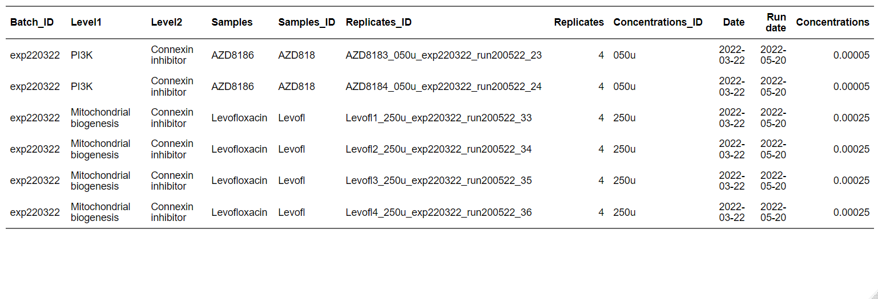
Data management
Final objective: check replicates, set of experiences, concentrations, drug mapping, …
Metadata Barcoding general recommendations: https://mbmg.pensoft.net/article/58056/
Final public database: ENA, NCBI GenBank , CellLine Atlases, arc-virtual-cell-atlas, cellosaurus…
add time course

Slide 14
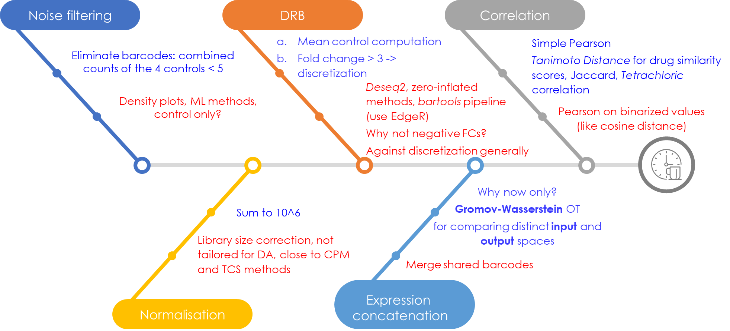
Luca’s Analytical Pipeline
https://www.linkedin.com/posts/shimon-shrem-5411b51_correlation-coefficients-are-powerful-tools-activity-7310311906777473025-CA8a
Phi coefficient
sum
Alternatives for computing similarity scores with binary data: https://cedar.buffalo.edu/papers/articles/CVPRIP03_propbina.pdf
Side Question: how do you generate your infographies :-) ?

Slide 15
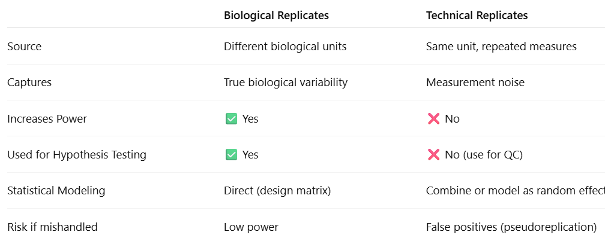
Biological versus technical replicates

Slide 16
Practical aspects
GitHub (privacy, on code snippets, and final output?)
Language R + renv + tidyverse
Reporting: Quarto (docx + html): commenting through Hypothesis (PR for Vera? :-))
Datasets storage and access? Data Tracking with DataLad or DVC ou cellosaurus
Computational resources (IFB core cluster?)
Zotero for sharing biblio resources.
Paper? Position within it.
NDA agreement (which purpose?)
Naming files: https://www.linkedin.com/posts/%F0%9F%8E%AF-ming-tommy-tang-40650014_stop-losing-track-of-your-analysis-files-activity-7311382817110708225-Kl3A (from Ming Tommy Tang)

